Slide 1
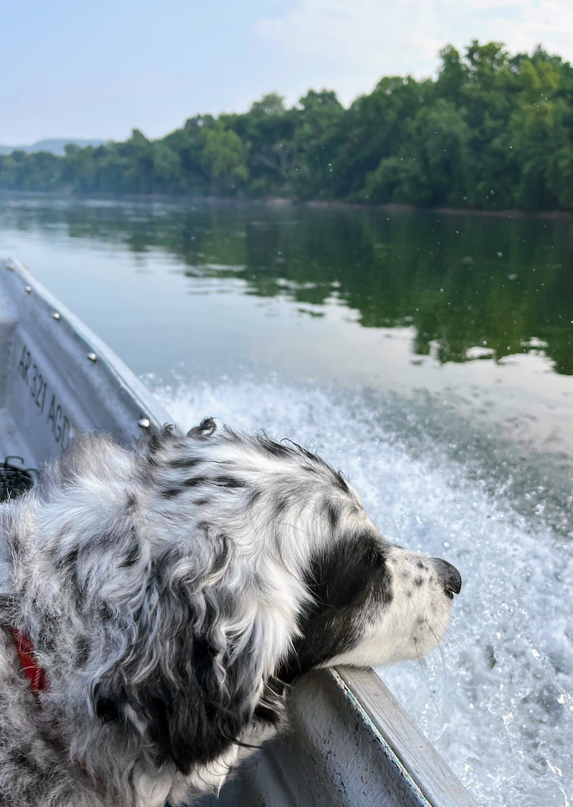
On the bitstream…one event at a time
Dr. Shannon Beck
Dept. of Computer and Cyber Sciences
United States Air Force Academy
13 June 2023 – GenCyber Teacher Camp - UCCS

Slide 2
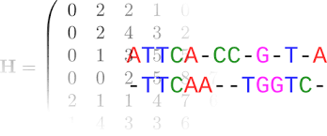

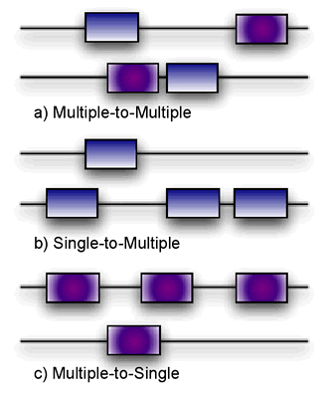

Bioinformatics

Slide 3
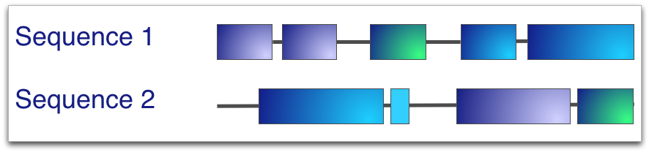
Pairwise Sequence Alignments

Slide 4
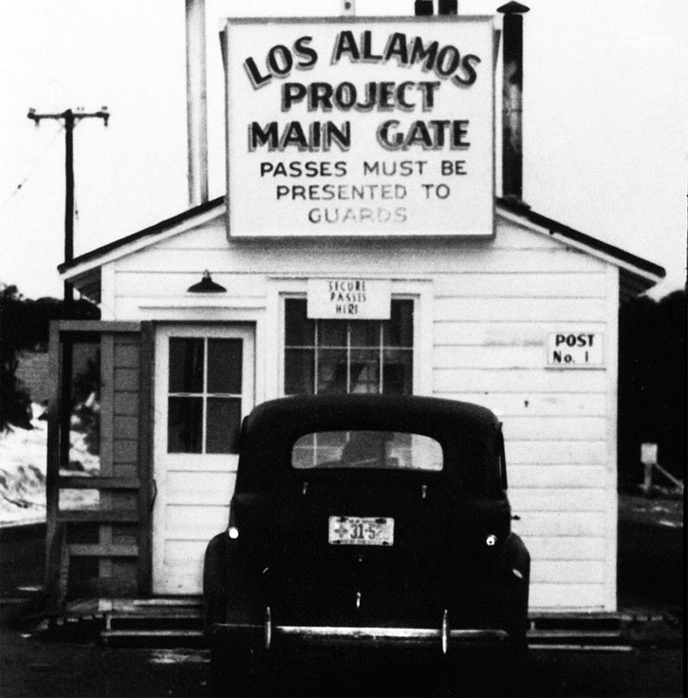


Slide 5
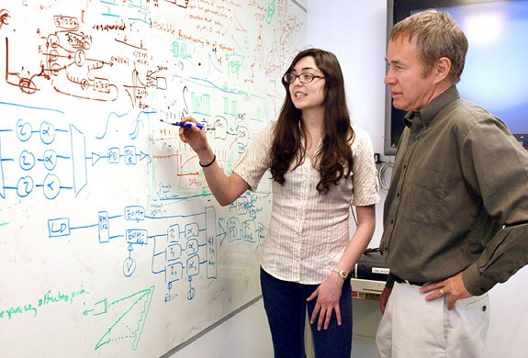
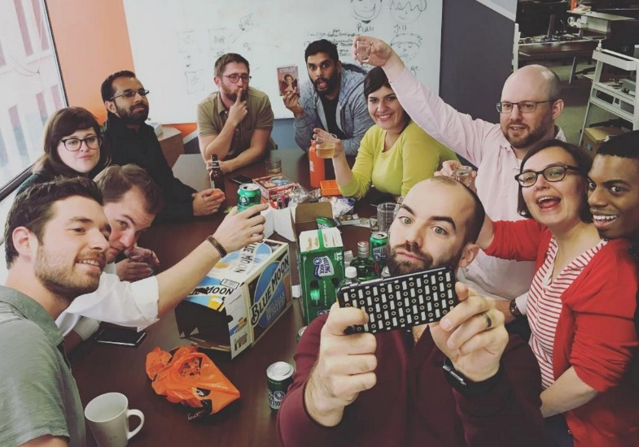


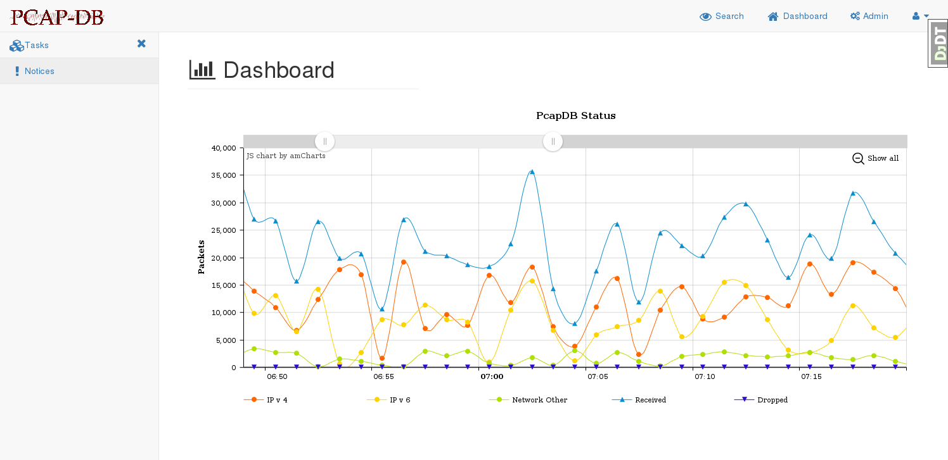
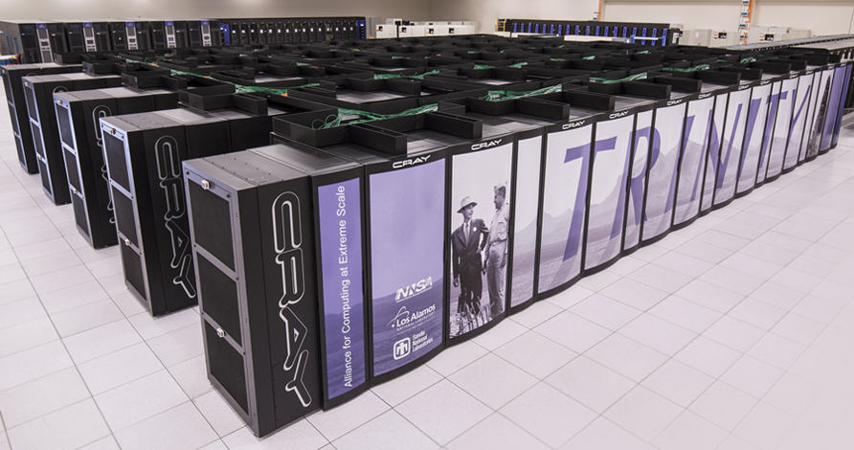

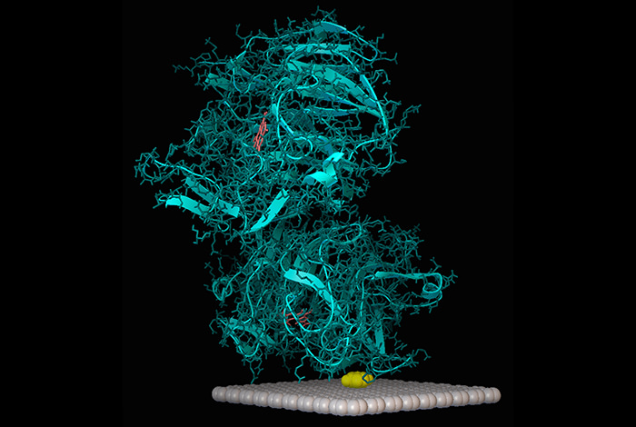
R & D

Slide 6
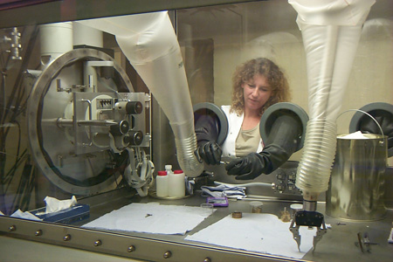
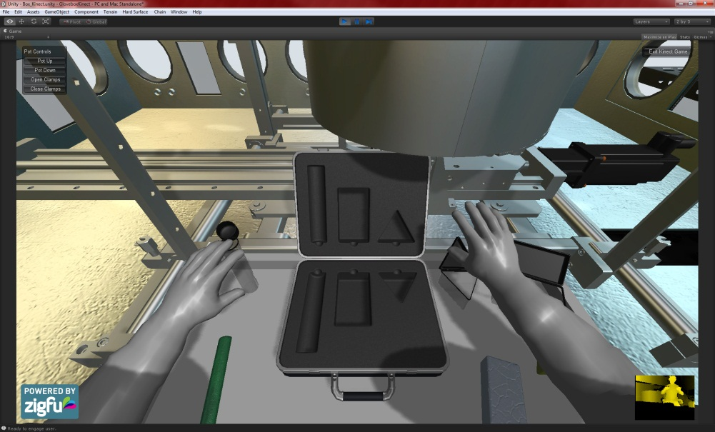
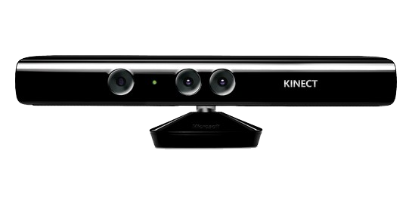
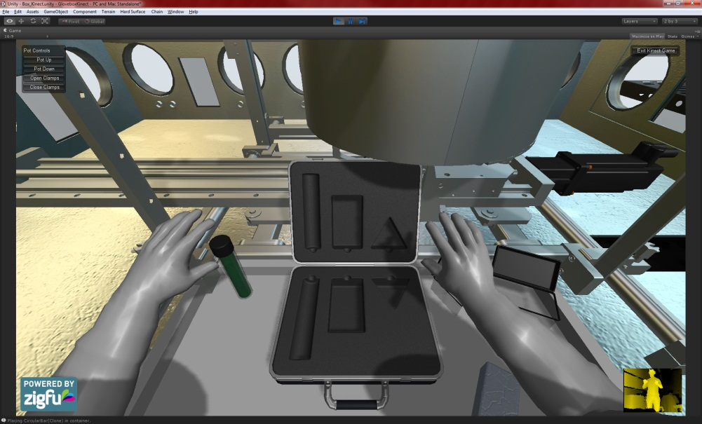
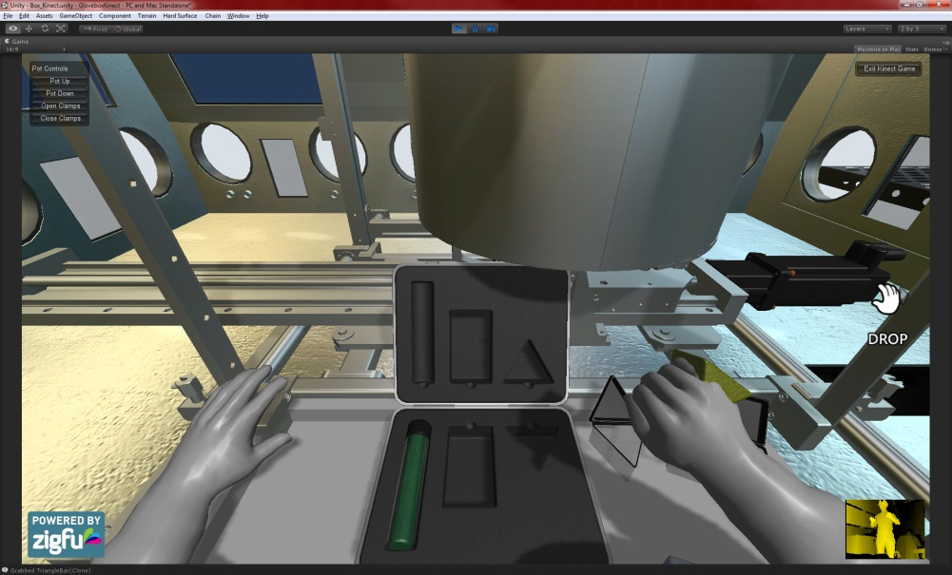
Kinect Controlled Glove Box

Slide 7
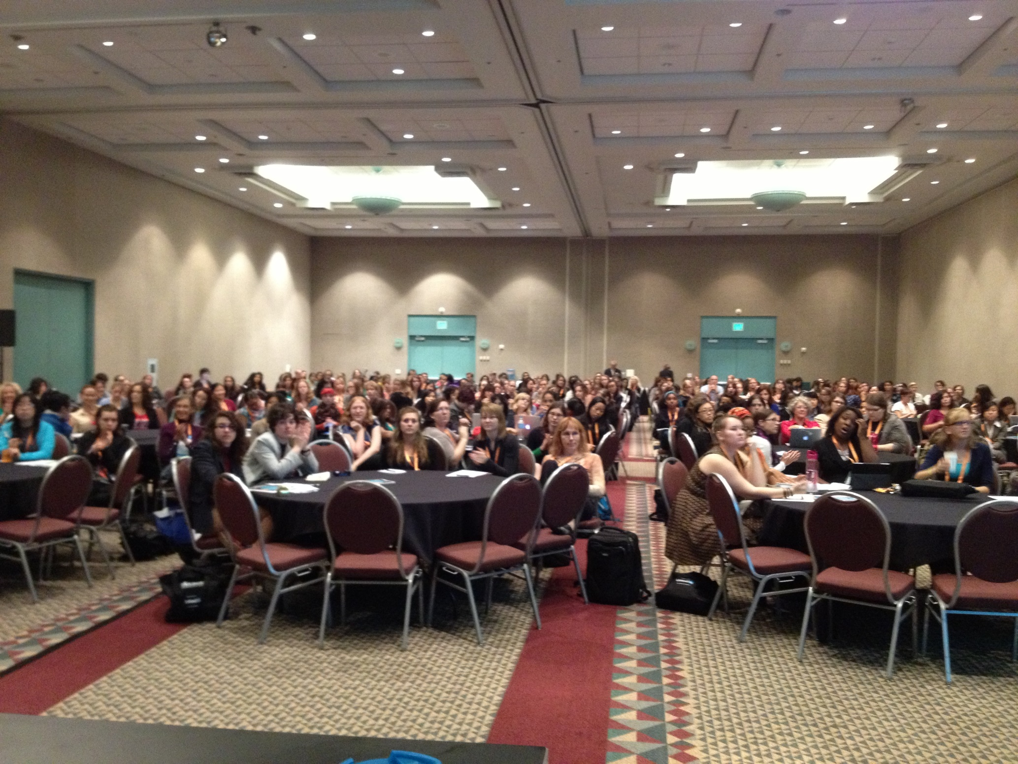
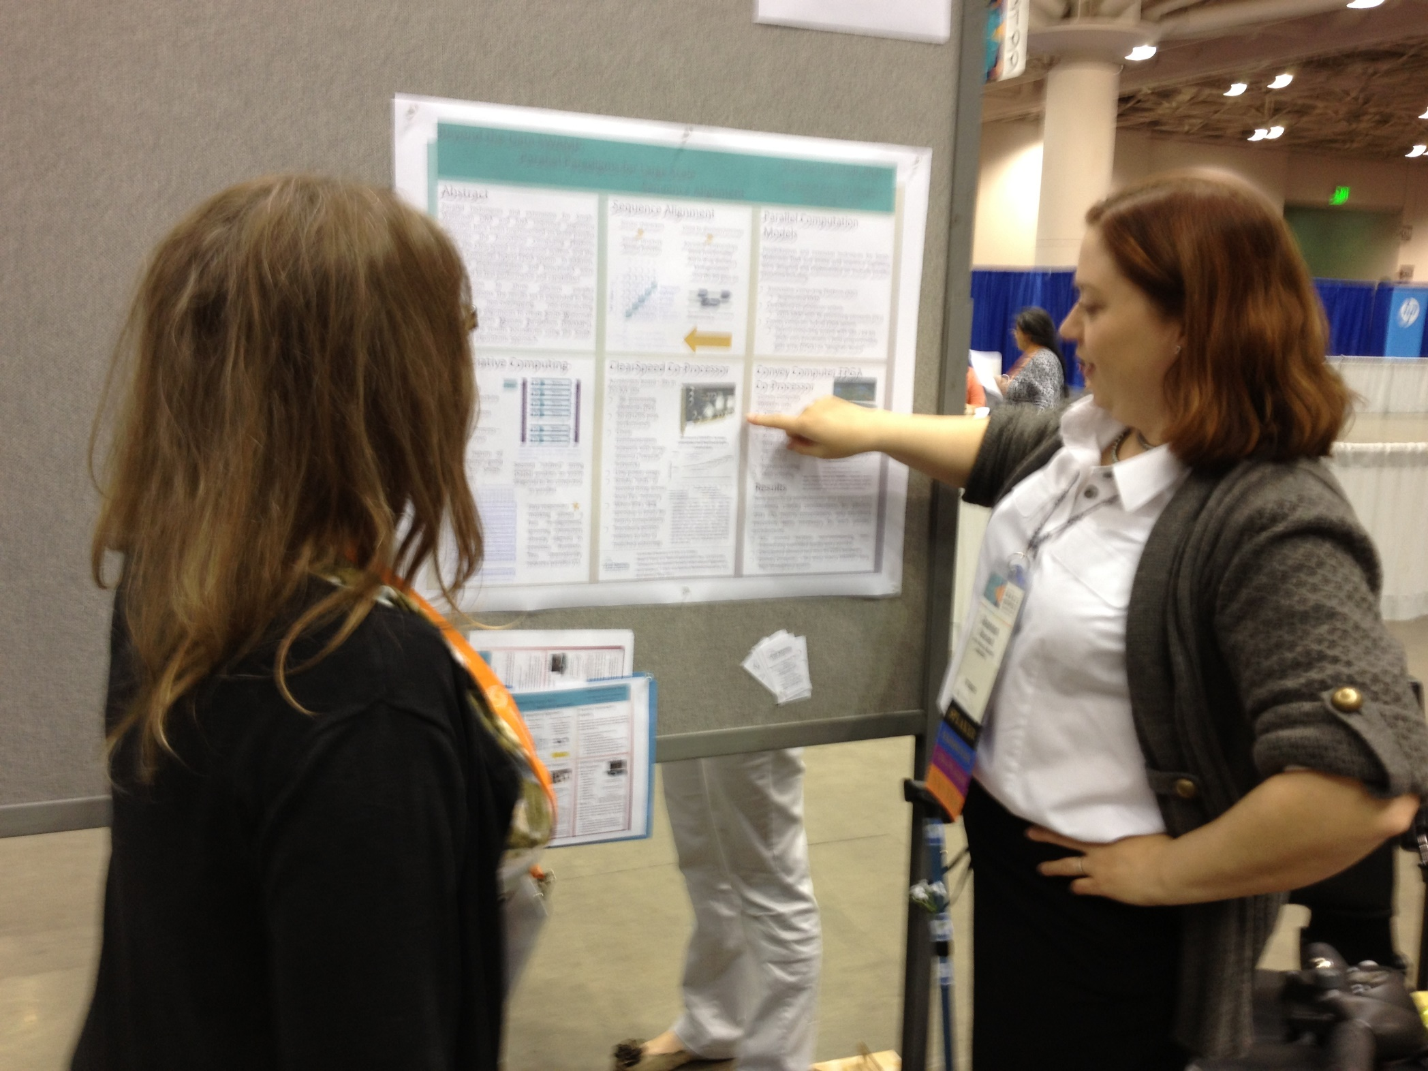

Slide 8
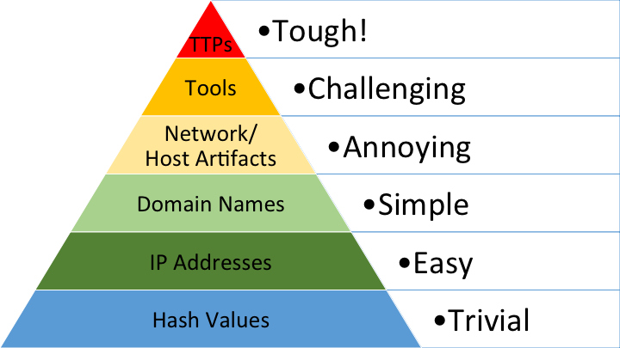
Cyber Security

Slide 9
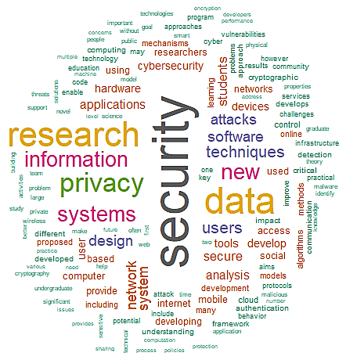

National Science Foundation – Secure and Trustworthy Cyberspace
Where discoveries begin

Slide 10
Cyber Unplugged Activity
Ciphers and History
Files available at https://github.com/shannonbeck/CyberOutreach/

Slide 11
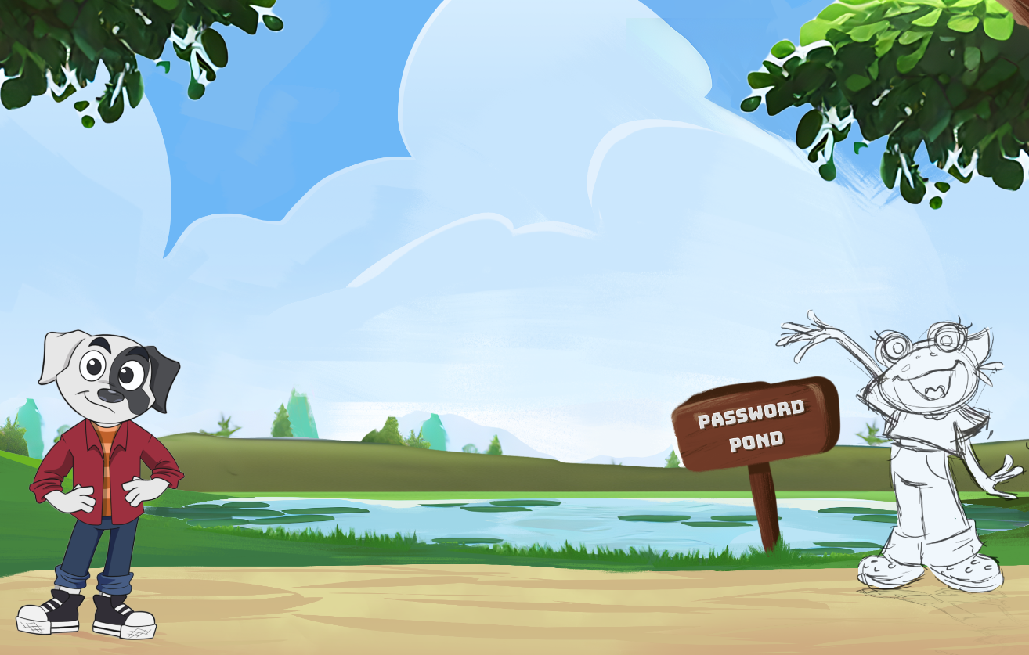
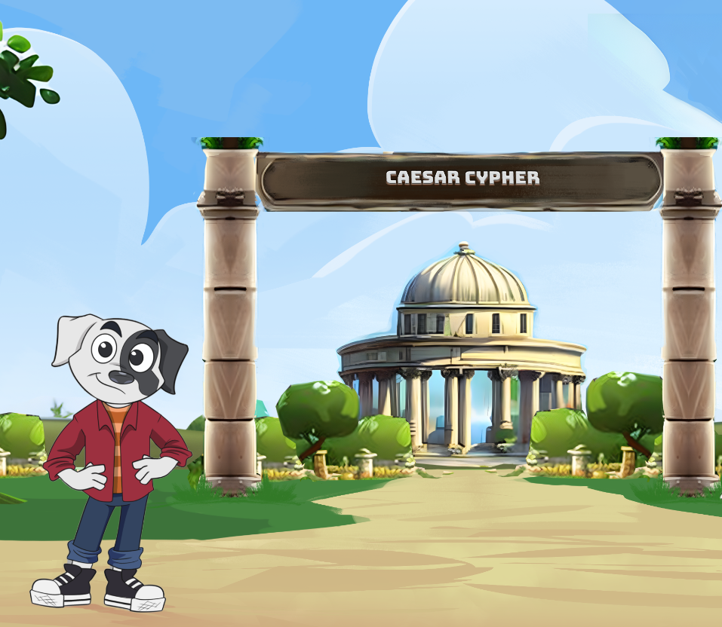
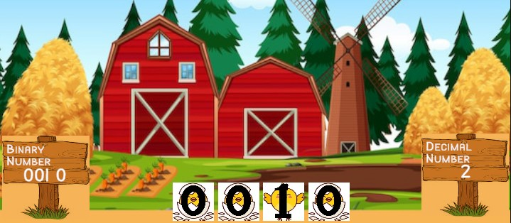
Cyber Pup
Middle School – Cyber Awareness and Hygiene
https://CyberPup.Academy

Slide 12
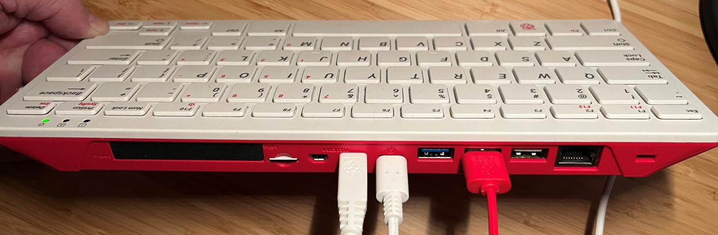
Cyber in Action
Raspberry Pi 400 – setup description and three labs from UMGC GenCyber Teacher Camp
https://github.com/shannonbeck/KaliOnRasberryPi
Interactive demos
https://www.uic.edu/apps/strong-password/
https://haveibeenpwned.com/ - check email and phone number for data breach info

Slide 13


K12 Focused Cybersecurity Resources
NIST NICE K12 Community
Annual Conference
https://www.k12cybersecurityconference.org/
K12 Cyber Ed Community of Interest
https://www.nist.gov/itl/applied-cybersecurity/nice/community/community-coordinating-council/k12-cybersecurity-education
Google drive: https://groups.google.com/a/list.nist.gov/g/NICEk12education?pli=1
Air Force Cyber Patriot
Camps, HS competition teams, elementary initiative
https://www.uscyberpatriot.org/
Cyberseek.org
Partnership with NICE, Lightcast and CompTIA for Cyber Jobs Information
https://www.cyberseek.org/

Slide 14



K12 Focused Cybersecurity Resources (2)
Cyber.org (was DHS funded)
Cyber and other modules that are “Empowering Educators to Teach Cyber”
LMS modules, workshops and more
https://cyber.org/
Teach Cyber
HS (oriented for dual college credit) year-long cyber curriculum with slides and hands-on labs, hold PD opportunities
https://teachcyber.org/
Clark.center (NSA co-funded)
“CLARK is the largest platform that provides FREE cybersecurity curriculum”
Educators upload modules for sharing / use. Consistency / length an issue.
https://clark.center

Slide 15

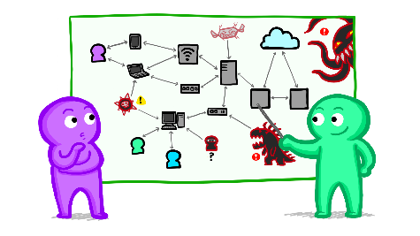


K12 Focused Cybersecurity Resources (3)
National Cybersecurity Training & Education (NCYTE) Center
Curriculum, modules and more
https://www.ncyte.net/faculty/cybersecurity-curriculum
TeachingSecurity.org
Introduce foundational ideas of cybersecurity (NSF grant funded), 3 main lessons
Hold PD opportunities
https://teachingsecurity.org/
Computer Science Teachers Association (CSTA)
K12 computer science educators
https://csteachers.org/
DHS Cybersecurity & Infrastructure Security Agency (CISA)
https://www.cisa.gov/resources-tools/training?f%5B0%5D=training_topic%3A68

Slide 16


K12 Focused Cybersecurity Resources (4)
NSA Centers of Academic Excellence in Cyber (NCAE-C)
https://www.caecommunity.org/
K-12 Pathway Program: RING - online high school cybersecurity course
https://caecommunity.org/initiative/k12-ring
CSSIA Emates – interactive CS, networking and cyber lessons
https://www.cssia.org/interactives/
And more….

Slide 17
Professional Organizations and Current Information
External list of orgs: https://www.zubairalexander.com/blog/list-of-cybersecurity-associations/
National Cyberwatch Center (higher ed focused) -https://www.nationalcyberwatch.org/
Women in Cybersecurity (WiCyS) - https://www.wicys.org/
Women Society of Cyberjutsu - https://womenscyberjutsu.org/
CSTA - https://csteachers.org/
SANS Training (SANS Ouch! and Bytes newsletters - https://www.sans.org/newsletters/ouch/
IEEE and ACM
Podcasts:
Cybersecurity Today (synopsis of cyber news M/W/F) https://www.itworldcanada.com/category/security
Risky.biz podcast (more technical reporting) https://risky.biz/
Websites
https://www.BleepingComputer.com/
https://thehackernews.com/
https://www.securityweek.com/
https://www.darkreading.com/

Slide 18
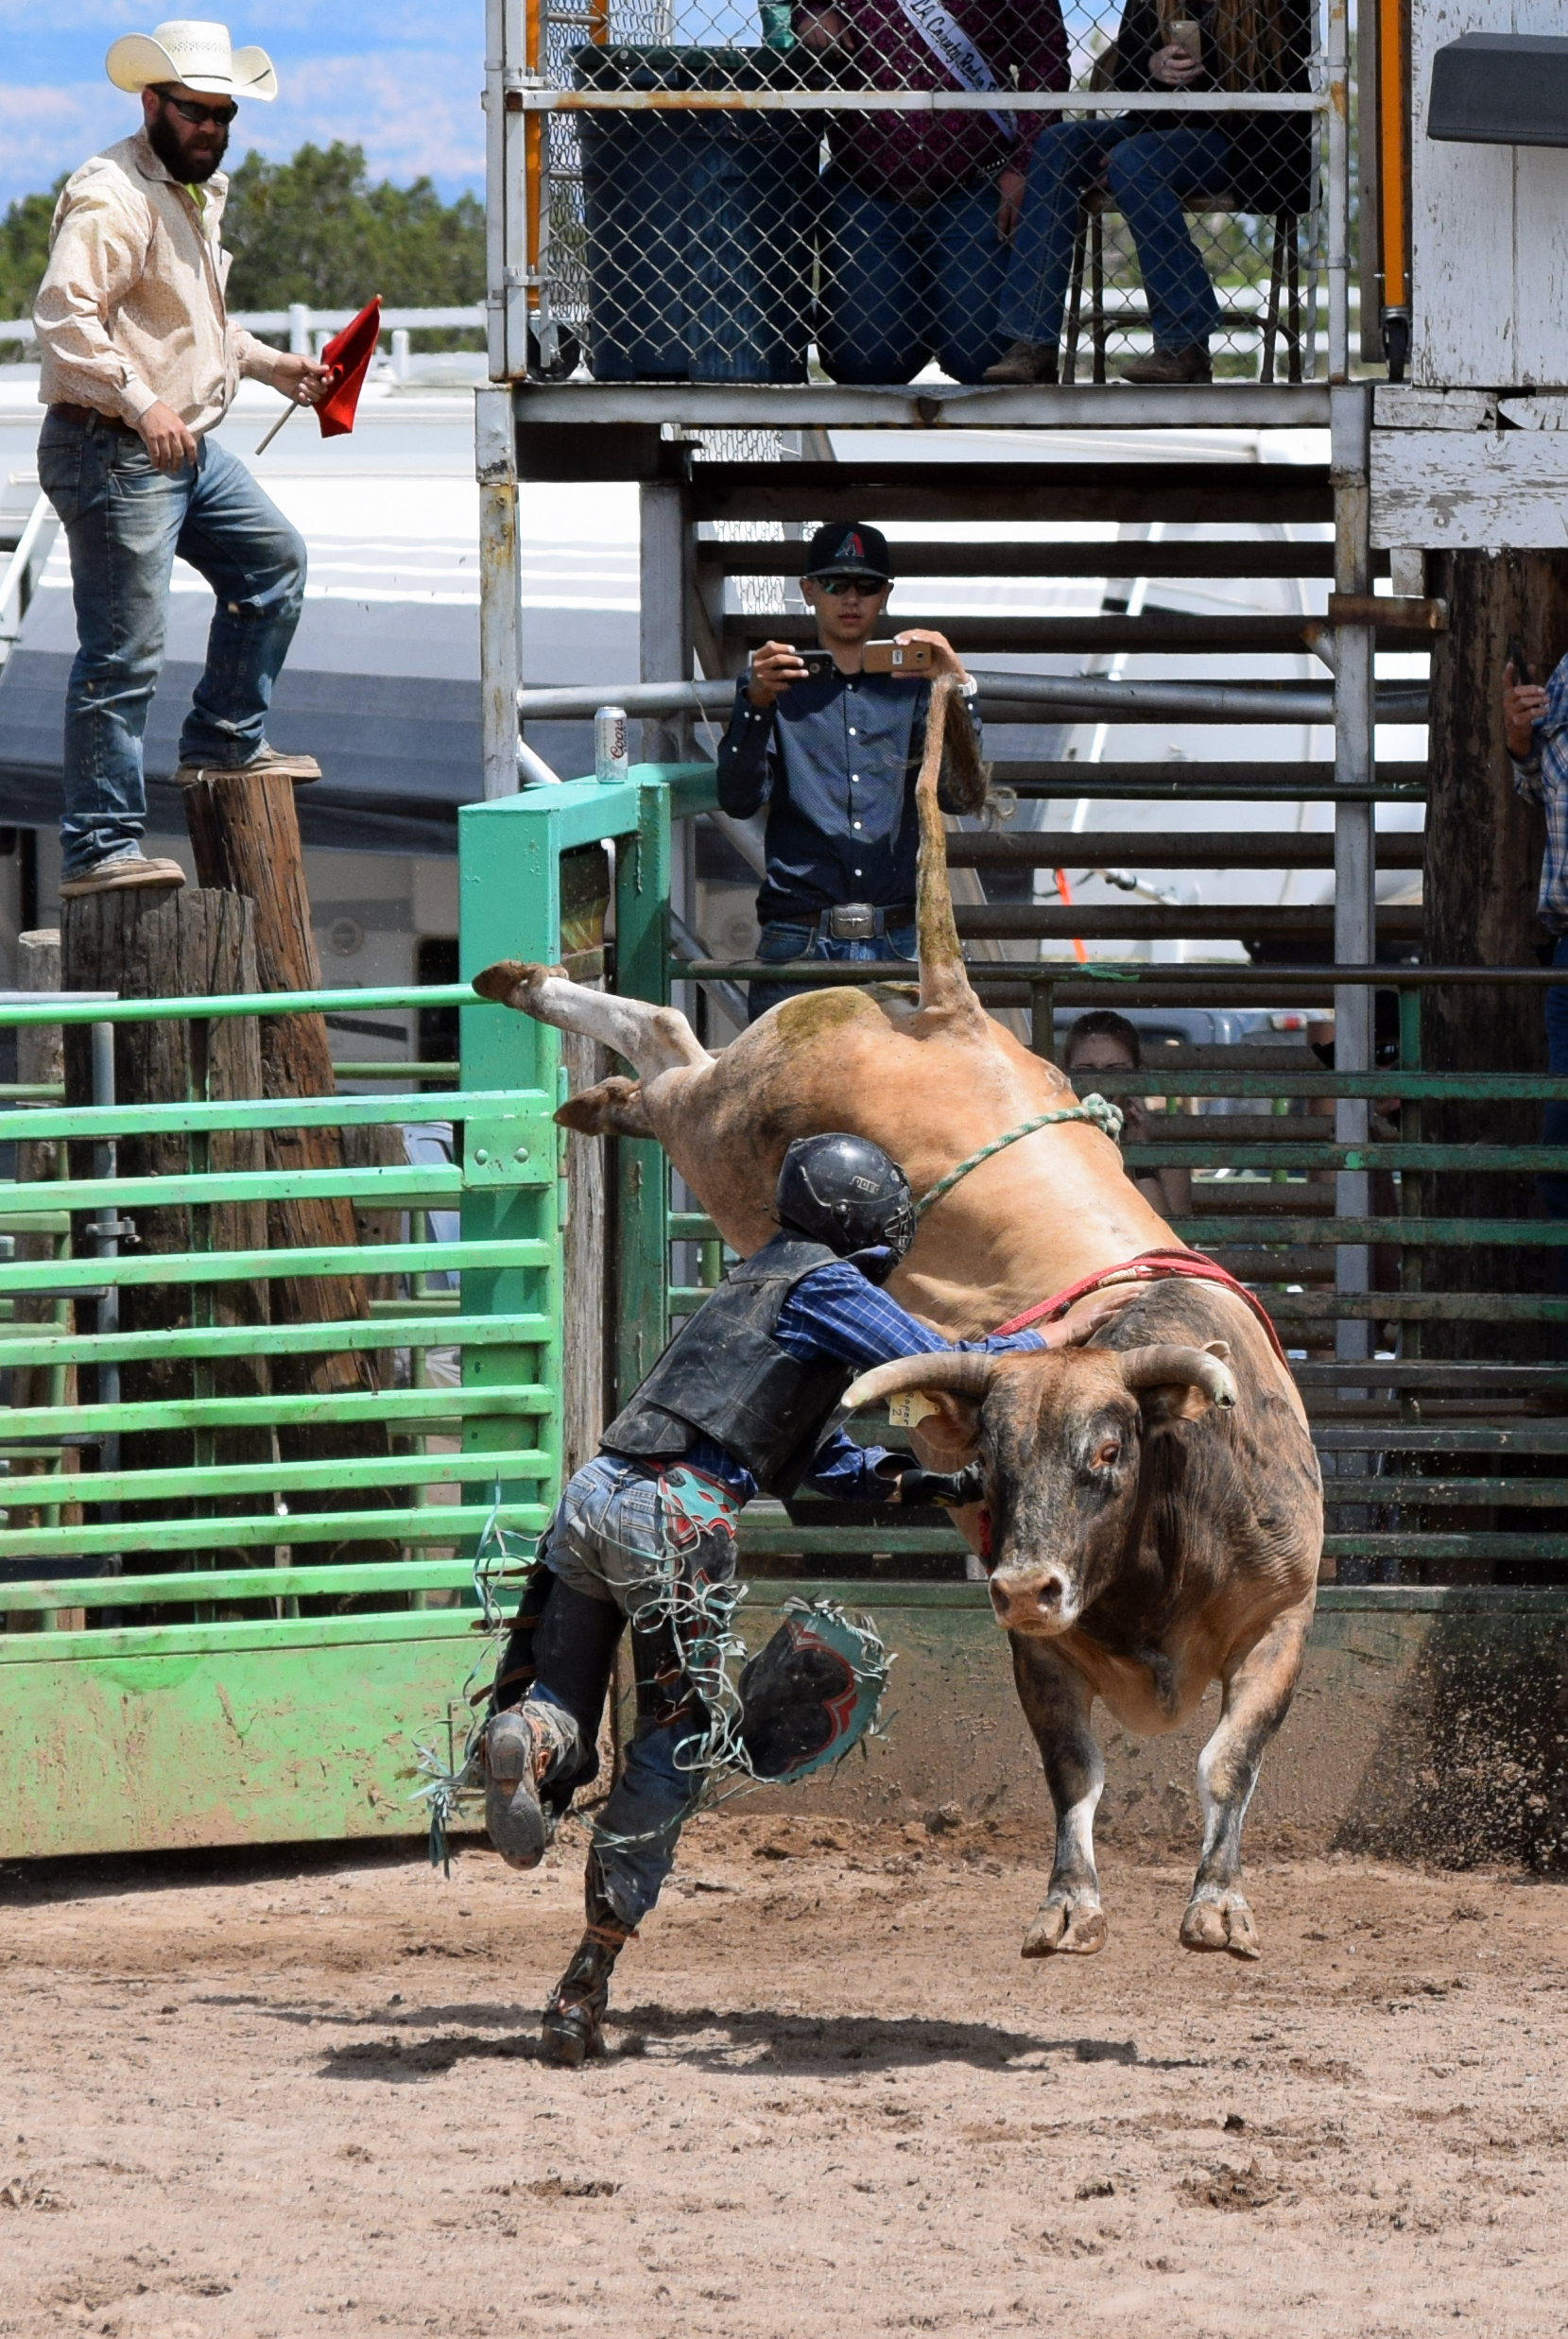
Let’s Chat

